Slide 1
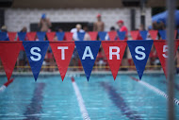


WELCOME!
Steiner Stars
RED & BLUE
Parent Meeting
April 23rd, 2023
Notes:
HI STARS!
My name is Jason Yunker, I am your Stars President for 2020 and 2021. Welcome to the team, and welcome to the New Parent Orientation.

Slide 2
2022-2023 STARS Executive Board
Position | Name
Past President | Amy and Jason Franklin
President | Andrew Struck
Vice President | Jenni and Scott Carter
Treasurer | David Horner
Secretary | Maggie Runyon
Team Coordinators | Tracy Miller/Emilie Clement/Candice Palmer
Circuit Rep | Erin Watson/Emily Nelson
Fundraising | Jami Delanoy
Equipment | Evan Machnic
Spirit (Social) | Molly Ebeier
Notes:
I am your President, 2020, 2021 We did not have a season last year, so we all rolled our volunteer positions into this year.
Vice Presidents Amy and Jason Franklin. I mention Amy first because she’s unstoppable, but Jason has been instrumental in the last year keeping us running. They will both serve well as presidents next year and I am grateful to have their help over the last year.
David Parchen has served as my mentor for three years and Past President for two years. He’ll move on to spend more time with his family, as we say in the corporate world, but he won’t be going far and we appreciate everything he’s done.
Our Treasurer is Keitha Peacock. She pays the bills and remembers to do all the stuff that wakes me up at 2:00 in the morning wondering if it got done
Louise Garrett has served as our secretary for two years now
Team Coordinators Tracy Miller and Amy Bedford are key players and we could not function without them.
Our Circuit Reps Maggie Acosta and Andrew Struck represent Stars Interest to the NorthWest Swim Circuit. I’ll tell you all about that in a bit.
Chris Rittter handles fundraising, apparel and Concessions. He’s the one that has brought us Chik-Fil-A this year, so be sure to thank him.
Chris Trevelise, perhaps the longest-serving parent in Stars History, handles our equipment, all the tents, computers, speakers and gear.
And last, but in no way least, Chris Hammond is our Social Chair and an all around force of nature.

Slide 3
Why We Swim…
It’s GREAT exercise!
We learn about competitive swimming, new strokes and try new events
IT’S FUN and make new friends!
We learn sportsmanship and teamwork.
We learn self-discipline & CONFIDENCE!
Notes:
Why We swim!
Tell the kids it’s For the exercise
This is where my predecessor liked to give a lot of statistics on the number of kids that drown in Texas and nationally because they don’t know how to swim. I think that’s all important, and participating in Summer League will make your child a confident swimmer, but here’s the best part: When you step onto a boat on lake Travis and the captain asks if your kids are OK with the water, you can just smile. When you drop them off at summer camp and they have to pass a swim test, your kid will be the one doing a butterfly across the pool. That actually happened. This is a good feeling.
We do it For the new skills, competition, and to improve our times
We do it for The Sportsmanship and Teamwork,
And we do it to encourage Discipline and confidence. Because nothing says discipline like a 4:30 wake up for a swim meet. ---you guys knew what you were signing up for, right?

Slide 4
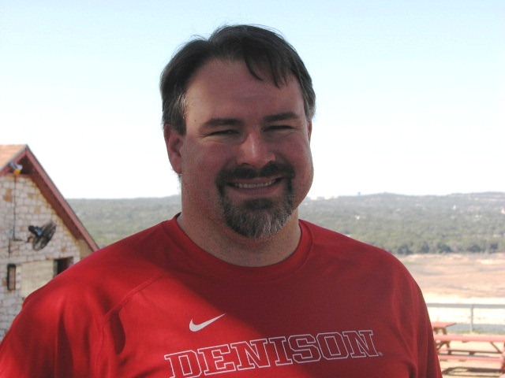
STARS Coaches!
BLUE Team Head Coach: Jeff Fellows
Head Coach of Blue Stars since 2014
Former Longhorn Aquatics swimmer
Attended Junior Nationals
Denison University Men’s Team Captain
7-time individual All-American
Local swim club coach
Notes:
Our Blue Team Head Coach is Jeff Fellows. He’s on the call as a panelist to answer any of your questions.
He’s a 7-time All American team captain from Denison University and a great guy. He’s been my kid’s coach on two teams for six years now.

Slide 5
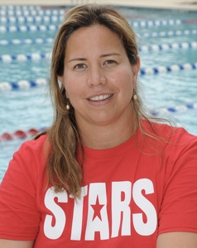
STARS Coaches!
RED Team Head Coach: Diana Aleman
Red team coach since 2014
Simon Fraser University, Vancouver, Canada
Gold Medal Central American Games
Member of Mexican National Team
Masters Degree in Education
Swim Mom!
Notes:
Red Team is coached by Diana Aleman and Tracy Nelson who have 20 years of coaching between them and have been coaching Stars since 2013.

Slide 6
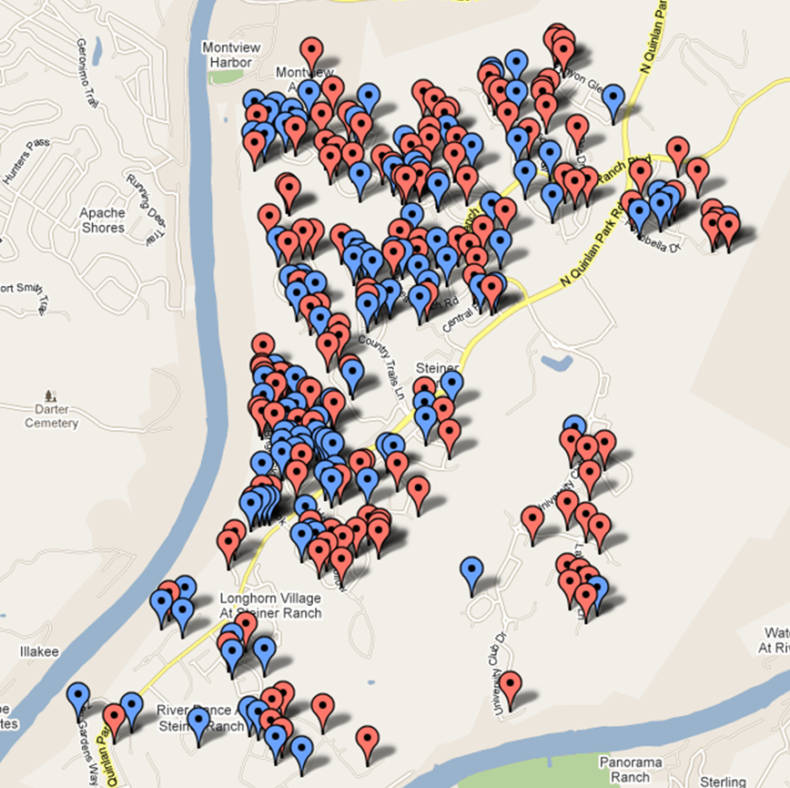
Who Are the Stars?
+250 Steiner Families
~ 450 swimmers
Thousands of past members and swimmers
Notes:
We are 250 Steiner Families 353 Swimmers this year. That number is lower this year because of COVID, with lower registration and capped numbers, we’re working with a smaller team.
We are also strongly represented in the rest of Steiner Ranch and outside by former members, swimmers, and families. And we enjoy the support of a large range of families in Steiner.

Slide 7
Northwest Swim Circuit Member Clubs
DIVISION I
Brushy Creek Marlins
Anderson Mill Barracudas
Steiner Stars RED
DIVISION II
Round Rock Dolphins
Georgetown Aquadillos
Forest North Stingrays
DIVISION III
Cedar Park Typhoons
Balcones CC Sharks
Block House Creek Tidal Waves
DIVISION IV
Pflugerville Piranhas
Wells Branch Armada
Rattan Creek Hurricanes
Steiner Stars BLUE
Notes:
Stars participates in the Northwest Swim Circuit, which is a competitive organization that encourages local competition and competes with other Swim Circuits around Texas, hosting an invitational meet following the end of the Summer League.
Summer League Swim meets are not USA Sanctioned events. This does not mean that the leagues and events are not approved by USA Swimming, only that the times earned at our events are not counted or ranked by USA Swimming the same as sanctioned events are.
You will hear parents talking about “STAGS” and “TAGS” and events at UT, San Antonio New Braunsfels. Those are the USA Swimming Events. We encourage all swimmers to broaden their experience and work with local clubs like Nitro, Waterloo, and Austin Swim Club and compete in USA Swimming Events, but Summer League, Northwest Swim Circuit, and Stars, is for fun, for competition, and for sportsmanship. Let your swimmers learn here. Maybe most importantly, let them fail here to learn their lessons, and let them grow here so that they can also compete here and later.
One thing you’ll hear regularly is Steiner parents with swimmers competing at the high school and college level, earning scholarships and going on to national programs who all say their kids got their start here, with Stars.

Slide 8
2023 Meet Schedule
RED
May 27th – @ Wells Branch
June 3rd – Anderson Mill
June 10th – @ Block House Creek
June 17th – @ Cedar Park
June 24th – BYE
June 28th – Star Wars @ Bella Mar
July 1st – @ Round Rock
July 9th – DIVISIONALS @ Bella Mar
July 10th – Invitationals - TBD
BLUE
May 27th – @ Block House Creek
June 3rd – @ Wells Branch
June 10th – Pflugerville
June 17th – BYE
June 24th – Georgetown
June 28th – Star Wars @ Bella Mar
July 1st – @ Brushy Creek
July 9th – DIVISIONALS @ Wells Branch
July 10th – Invitationals - TBD
Swimmers who qualify for INVITATIONALS will be notified of the event as more information is available
Notes:
This is the meet schedule for Steiner Stars. If you studied the previous slide carefully you’ll notice that there are plenty of Division II, Division III and Division IV teams across the meet calendar. While the divisions are ranked, they all swim against each other.
This year we are meeting only with teams that opted to swim virtually this year. There was a 60/40 split between teams whose boards opted to swim virtually and keep the meets localized to their own teams, including Stars, and teams that opted to host visiting teams and travel to other team’s pools.
As a board, Stars voted with the virtual teams to keep our swimmers and families within Steiner as much as possible and to minimize any cross-contact with other teams. It’s out of an abundance of caution, and while we are optimistic about the vaccine rollouts and opportunities to try to get back to normal, the Stars Board voted almost unanimously to keep the meets virtual this year.

Slide 9
2023 Meet Schedule
DIVISIONALS (July 8)
End of season meet with ALL THREE teams in each Division
All swimmers who have participated in a minimum of three meets are eligible
Important that we have ALL swimmers present – We NEED your swimmer there!
INVITATIONALS: (July 9)
Final meet of season for swimmers who have qualifying times (times are posted on our website)
Swimmers can qualify in all individual strokes, but can only compete in three
Location TBD
Notes:
Divisionals is the tri-meet held at the end of each year and it will be virtual this year as well, so it won’t look any different than the rest of the season.
Swimmers who have participated in a minimum of three meets are eligible, and we need as many swimmers as we can get in the pool to score the most points.
Our Invitationals meet this year is still up In the air because of COVID but it is likely to happen the day after Divisionals on July 11th. We will post more about that as the circuit finalizes plans.

Slide 10
STARS Practice Schedules
During the School Year: May 2nd – May 27th
Monday and Wednesday plus EO Friday at Bella Mar Lap Pool
  Ages 9-10 3:30-4:40pm
  Ages 5-6 4:30-5:25pm
  Ages 7-8 5:15-6:25pm
  Ages 11 & up 6:15-7:30pm
After School Gets Out: May 31st – July 8th
Tuesday – Friday mornings at Bella Mar Lap Pool
  Ages 13 & up 7:30-8:45am
  Ages 5-6 8:35-9:30am
  Ages 7-8 9:20-10:30am
  Ages 9-10 10:20-11:30am
  Ages 11-12 11:20-12:30pm
Notes:
This is the Red Stars practice schedule. It is also posted to the team webpage.

Slide 11
STARS Practice Schedules
During the School Year: May 2nd – May 27th
Tuesday and Thursday plus EO Friday at Bella Mar Lap Pool
  Ages 9-10 3:30-4:40pm
  Ages 5-6 4:30-5:25pm
  Ages 7-8 5:15-6:25pm
  Ages 11 & up 6:15-7:30pm
After School Gets Out: May 31st – July 8th
Monday through Thursday afternoons at Bella Mar Lap Pool
  Ages 5-6 1:30-2:30pm
  Ages 7-8 2:15-3:15pm
  Ages 9-10 3:00-4:15pm
  Ages 11-12 4:00-5:15pm
  Ages 13 & up 5:00-6:30pm
Notes:
Blue team practices are entirely custom this year to accommodate as many swimmers as possible.
You should have received an e-mail from Tracy Miller with your swimmers practice time. If you have not, please contact Tracy.

Slide 12
Practice
What your swimmer needs:
Competition Suit
Cap – preferred, especially if your child has long hair
Goggles
Fins
Towel
Water bottle…especially for afternoon sessions
Be on time
LABEL EVERYTHING!!!!!!!
Notes:
What your swimmer needs:
Competition Suit
Cap – All swimmers with hair.
Goggles
Fins
Towel
Water bottle…especially for afternoon sessions
Be on time
LABEL EVERYTHING!!!!!!! Thing do get lost.

Slide 13
Practice
DO’s & DON’Ts:
DO Download the Swimtopia App and keep Notifications enabled.
DO put sunscreen on your child BEFORE you come to the pool!
DO CHECK YOUR FAMILY FOLDER REGULARLY
DON’T enter the deck for any reason without prior approval by the Coach or a Board member – NO EXCEPTIONS!
DO supervise* your child(ren) in the play pool and on the playground (there are NO fins allowed in the playpool).
DO label EVERYTHING!
DON’T prop open the gates. This is a safety issue.
Notes:
DO’s & DON’Ts:
DO Download the Swimtopia App and keep Notifications enabled.
DO put sunscreen on your child BEFORE you come to the pool!
DO CHECK YOUR FAMILY FOLDER REGULARLY
DON’T enter the deck for any reason without prior approval by the Coach or a Board member – NO EXCEPTIONS!
DO supervise* your child(ren) in the play pool and on the playground (there are NO fins allowed in the playpool).
DO label EVERYTHING!
DON’T prop open the gates. This is a safety issue.

Slide 14
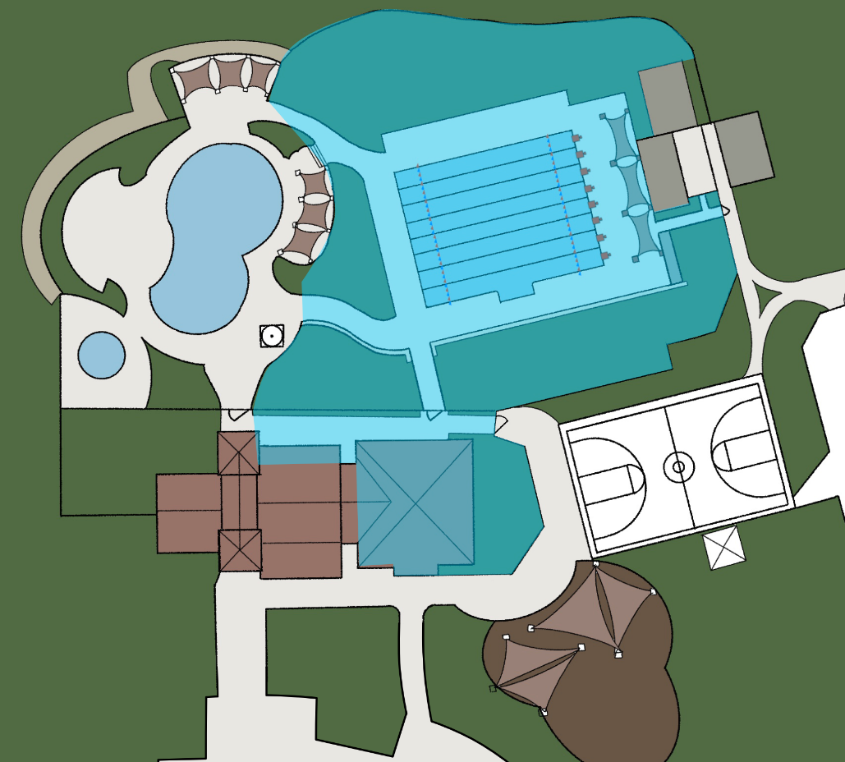
Practice
Notes:
During practice, it’s important to remember that only coaches and swimmers are allowed on the deck. That’s everything shaded in blue in this picture.
This year, we are doing this to ensure minimal exposure to COVID, but the real reason we do this is that the coaches have their hands full wrangling your swimmers. They cannot wrangle you as well.

Slide 15

During Practice
Lightning strikes within ten (10) miles will cancel practice.
Download Swimtopia and leave notifications on
Follow the Steiner Stars Facebook Page and turn on notifications.
Note that there is a “Steiner Ranch Swim Team” FB page that is not directly updated by Stars. We cannot guarantee posts to this page will be updated.
Notes:
Please note that in the event we have a passing lightning storm, which is defined as either thunder we can hear or a strike within ten miles, the current Practice session will be canceled.
We will notify parents using the SwimTopia app and on the Stars FB Page. Be sure to download Swimtopia and follow Steiner Stars on FB. Turn on Notifications.
A special caution that there is a Steiner Ranch Swim Team FB Page that frequently posts information on practice cancelations. That is not the official page and we do not directly post to that page.

Slide 16
Meets: Important Info
Most swimmers will be entered in no more than FIVE events: three individual and two relay events.
Coaches will take swimmer preference into account when submitting entries.
Coaches will also take team needs into account.
Swimmers will be encouraged to swim outside their comfort zone and try new events.
Swimmers will only be entered to swim strokes in which they are proficient and legal.
Occasionally we will have to take meet shortening measures and cut events without warning.
Notes:
Most swimmers will be entered in no more than FIVE events: three individual and two relay events.
Coaches will take swimmer preference into account when submitting entries.
Coaches will also take team needs into account.
Swimmers will be encouraged to swim outside their comfort zone and try new events.
Swimmers will only be entered to swim strokes in which they are proficient and legal.
Occasionally we will have to take meet shortening measures and cut events without warning.

Slide 17
Meets: Important Info
Read the MEET INFO email sent by the Team Coordinator.
Arrive EARLY! Arrival time will be announced the week before. DO NOT BE LATE! or your swimmer will be scratched from the meet.
Check your swimmer in with the Team at their tent
Check yourself in with the Volunteer Coordinator.
Wear your nametag!
Put sunscreen on your swimmer AFTER they have been body-marked!
Clean up after yourself and ask your swimmer to do the same.
Label ALL of your swimmer’s belongings.
REPORT ALL MEET ABSENCES ASAP!!
Notes:
Read the MEET INFO email sent by the Team Coordinator.
Arrive EARLY! Arrival time will be announced the week before. DO NOT BE LATE! or your swimmer will be scratched from the meet.
Check your swimmer in with the team
Check yourself in with the Volunteer Coordinator.
Wear your nametag!
Put sunscreen on your swimmer AFTER they have been body-marked!
Clean up after yourself and ask your swimmer to do the same.
Label ALL of your swimmer’s belongings.
REPORT ALL MEET ABSENCES TODAY!!

Slide 18
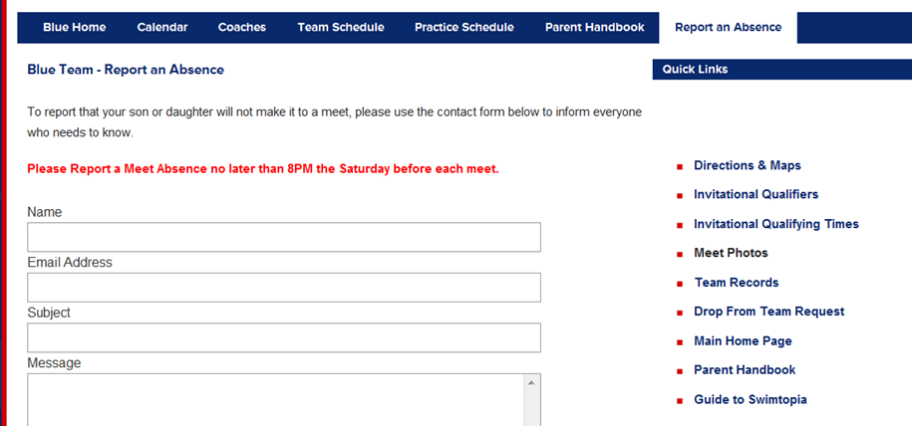
Meets: Important Info
Report ALL meet absences AS SOON AS POSSIBLE!!
Notes:
Report any meet absences on the webpage as soon as you know it will happen. We understand that things come up and summer vacations pose scheduling challenges, but our coaches will be scheduling your swimmer for individual heats and relays. The sooner we know they won’t be there, the better.

Slide 19

VOLUNTEERING!
We rely on our volunteers 100%. The Stars cannot function without you!
We need 120 Volunteers for Home Meets.
Each family is required to serve a cumulative total of eight (8) points per season.
Use Swimtopia to sign up for shifts.
Notes:
Here’s the real reason we have you all here:
Steiner Stars is an all-volunteer organization. We function entirely on volunteer efforts. Other organizations have a process where they ask for volunteers and watch as a lot of parents take two steps backwards. That is not allowed in Stars.
We do require that you serve a minimum of five (5) shifts per family per season. If you do not fulfill your shifts by the end of the season, the penalty is one season off and you get to sign up as new parents the following year. We do not like doing this and I had to do it with one family this year. Their kids are not happy. Please do not put us in this position.
The good news is it’s not hard to fill your hours. There are plenty of opportunities, and we have fewer required volunteer hours this year because of the shorter season.
But here’s the universal truth about volunteering for your kids’ sports: Just like everything else, you as a parent will get out of this program exactly what you put in. No more. No one’s saying you have to sign up for a board position (which I recommend), but sign up. Get to know the other parents. Get to know the kids. It’s worth it.

Slide 20
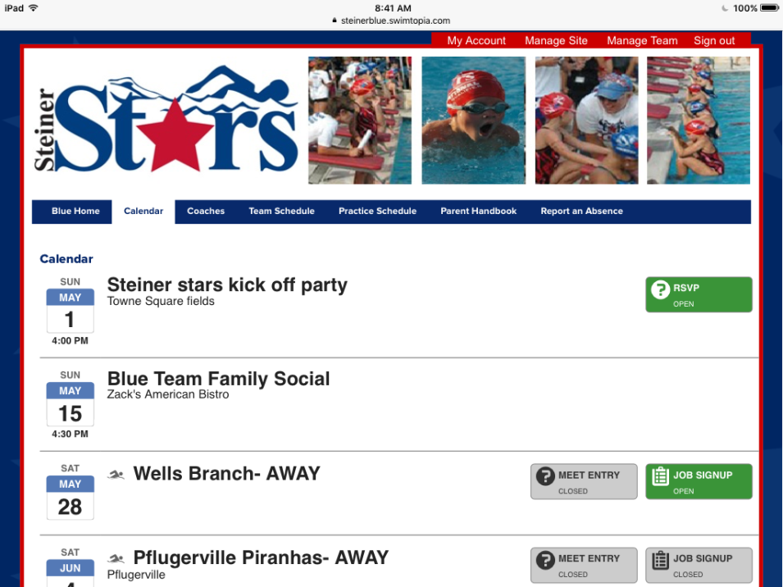
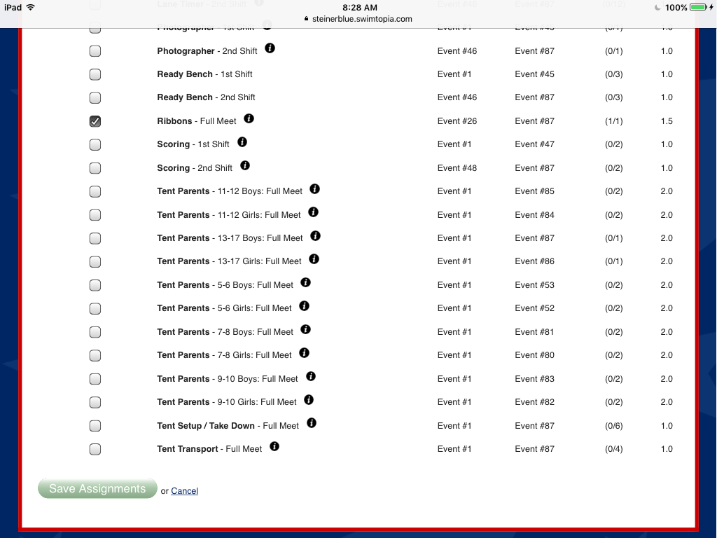
Volunteering: Swimtopia
Volunteer signups will open up on Sunday nights at 9pm,
2 weeks before the meet
Rolfsen ASC | 7402 | 1 | Rolfsen | 2024 | 23-Feb | John and Corey had initial discussion on subject. | 4/6 IOL meeting - Corey and John to follow up
Notes:
USE SWIMTOPIA on Sunday Nights two-weeks before each meet to sign up for shifts.
This can be a bit of a nerve-wracking experience as several choice shifts will fill fast, but please be patient, grab what you can, and remember that every position is vital to pulling off our season. We will work with you to ensure you can fill your shifts.

Slide 21
VOLUNTEERING!
If you are struggling to meet these requirements it is important that you reach out to your respective Volunteer Coordinator ASAP!
  Red – volunteer-coordinator-red@steinerstars.org
  Blue – volunteersteinerblue@gmail.com
Notes:
Here’s the real reason we have you all here:
Steiner Stars is an all-volunteer organization. We function entirely on volunteer efforts. Other organizations have a process where they ask for volunteers and watch as a lot of parents take two steps backwards. That is not allowed in Stars.
We do require that you serve a minimum of five (5) shifts per family per season. If you do not fulfill your shifts by the end of the season, the penalty is one season off and you get to sign up as new parents the following year. We do not like doing this and I had to do it with one family this year. Their kids are not happy. Please do not put us in this position.
The good news is it’s not hard to fill your hours. There are plenty of opportunities, and we have fewer required volunteer hours this year because of the shorter season.
But here’s the universal truth about volunteering for your kids’ sports: Just like everything else, you as a parent will get out of this program exactly what you put in. No more. No one’s saying you have to sign up for a board position (which I recommend), but sign up. Get to know the other parents. Get to know the kids. It’s worth it.

Slide 22



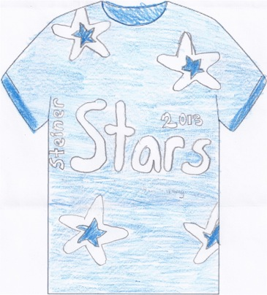


Meets: What to Bring
Book, game, CHAIR, blanket, flip flops…
Notes:
Let’s talk about Meets: What to bring:
You’re going to be there a while, so bring comfortable chairs, your phones, water and some food and a book to read.
Bring extra towels, goggles, and sunscreen. Big floppy hats are always good. They’re walking shade.
Visit the Stars page for additional gear like towels, shirts, etc.
One cap and one shirt per swimmer will be provided in your family folders. For suits and other gear, we are working to have D&J Sports available the first week of practice, and you can always swing by their Anderson Mill Location
13359 US Hwy 183 N, Suite 402, Austin, TX 78750

Slide 23
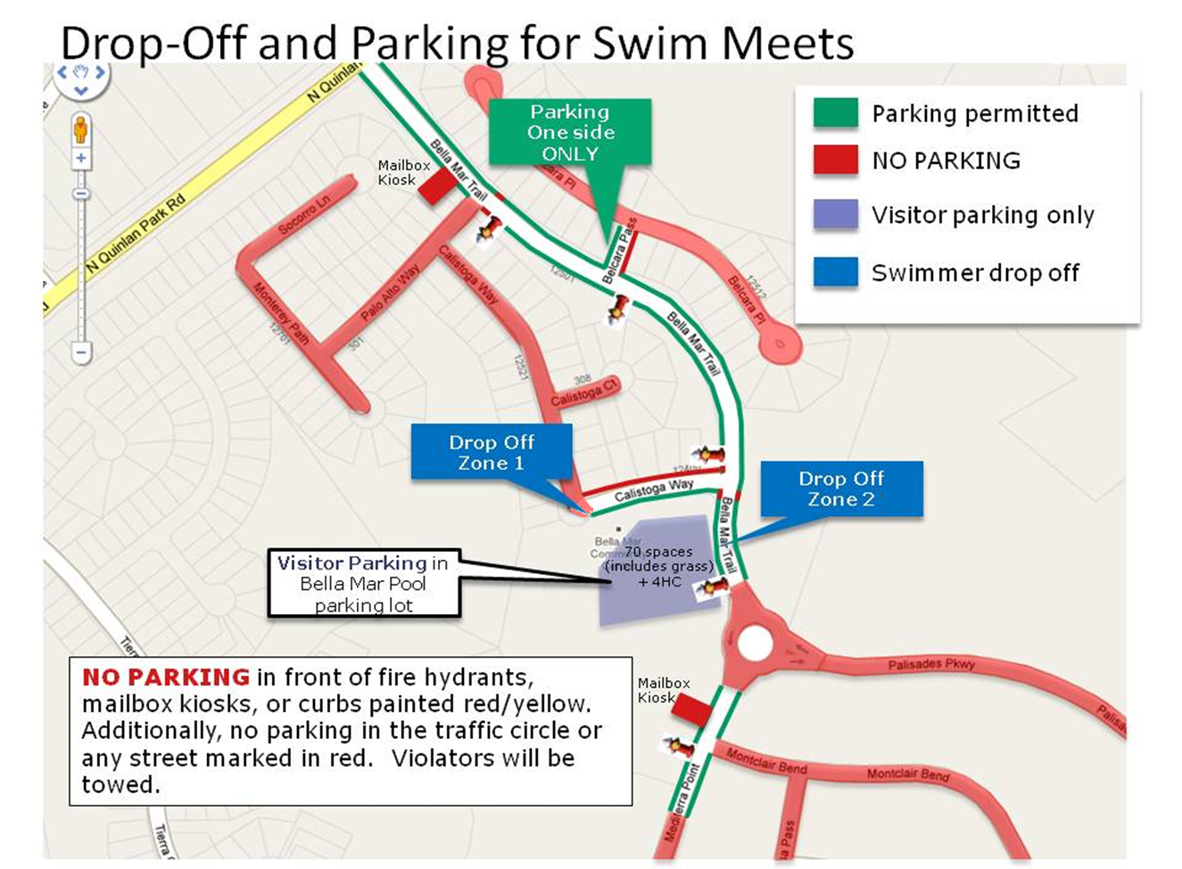
Meets: Important Info
Notes:
For the meets, we will have parking volunteers. Please follow their advice. Park along Bella Mar Drive, but generally speaking, nowhere else.
This season, all meets will be in Bella Mar. If you live close, consider walking. If you can carpool, great. Remember that we’re taking up a lot of space, so please be courteous to the Bella Mar residents.

Slide 24

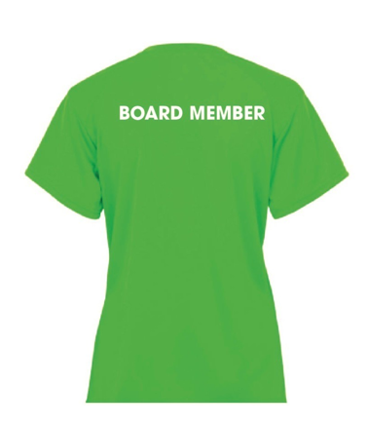
Meets: Important Info
Have a question during the meet?
  Find a Board Member and ask for help
  Look for the lovely NEON GREEN SHIRTS
Notes:
For the meets, we will have parking volunteers. Please follow their advice. Park along Bella Mar Drive, but generally speaking, nowhere else.
This season, all meets will be in Bella Mar. If you live close, consider walking. If you can carpool, great. Remember that we’re taking up a lot of space, so please be courteous to the Bella Mar residents.

Slide 25
Social Events!
Kick Off Party – 4/30 – 4-7PM, Bella Mar
Movies in the Park – 6/11 – Towne Square Park
Typhoon Texas Stars Day – 6/25 - Tentative
Star Award Banquets
  Red – 7/11
  Blue – 7/10
You will receive future communication on all of these!
Please also check the website!
Check the website (www.steinerstars.org) for updates on more social events!
Notes:
Our Social Coordinator Chris Hammond has been working tirelessly to have as much fun out of the pool as possible. To minimize COVID exposure, we are not planning any indoor events this year.
The HOA has forbidden the use of the Towne Square field for our kickoff party, which we would otherwise hold next week.
Because of this, please check your family folders that will be accessible the first week of practice for swim caps, required materials and gear.
We usually host our Awards Banquets following Divisionals, one for each team. This year, while we are cautiously optimistic, we’re in a position where we need to play it by ear and we have not yet scheduled the banquets.

Slide 26

Stars & the Community
Respect our Bella Mar neighbors – ABIDE by parking restrictions. Take the shuttle when available.
Carpool, ride bikes, or walk whenever possible.
Help keep Bella Mar clean!
Be an ambassador for our organization – invite friends & neighbors to watch meets.
Remind others that STARS are Steiner Ranch residents.
Notes:
We want to remind everyone that we are the single-largest organization in Steiner Ranch, and that we take up a lot of space. Because of that, we sometimes run into residents who do not share our love of the sport and do not appreciate us taking up the pool and street space and waking them up on Saturday morning.
You’ll sometimes see them on social media, and occasionally run into them in person. When you do, please remember that we are all ambassadors for the program. Be courteous, and respect Bella Mar during meets and practices, and remember that we are part of this community, that we are a large part of this community, and that we all share the same community.

Slide 27

Show your STARS pride!
Notes:
Take a look at the Stars page for merchandise, clothing, towels, yard signs, and this year, stainless steel Stars cups. Proceeds go toward supporting the team, and the cups are super-cool.

Slide 28
FAQs
What are the minimum swimmer requirements to participate?
  A swimmer must be able to make it across the length of the pool unaided. The swimmer cannot hang on the lane line or touch the bottom of the pool.
  A swimmer must be willing to go on the deck without his/her parents.
  A swimmer must be willing to jump in the water.
What type of suit should my swimmer wear to practice?
  To keep the team suit in good condition, we recommend getting a second suit for practice. The suit needs to be a “competition” suit. For girls, that means a “racing” one piece…no tankini or bikini. For boys, that means jammers…no board shirts. No swim shirts for boys or girls.
What is required to be considered a returning family?
  A swimmer must swim in three meets.
  The family must complete a minimum of eight volunteer credits.
What is the order of events at a meet?
  6U free relays, 7/8-15/17 medley relays, individual events, 7/8-15/17 free relays.
Notes:
These FAQs will be posted to the webpage.

Slide 29
FAQs
How are the heats organized?
  Swimmers are assigned to heats according to their times.
    This gives each swimmer the opportunity to win his/her heat.
    The exception is when a swimmer does not have a time.
  Time improvement ribbons are given each time a swimmer improves his/her time in an event.
How do I sign up for volunteer shifts?
  The team uses Swimtopia to sign-up for volunteer jobs.
  Volunteer coordinators will notify you when the sign-up is open.
Will I receive training for my volunteer position?
  There is on-the-job training for the majority of the positions.
  There are specific positions (stroke judge, exchange judge, meet director) which require circuit approved training.
There is a great deal of information on our websites. Specifically, refer to the “Resources” on www.steinerstars.org or “FAQs” on the Red and Blue Team pages https://steinerred.swimtopia.com & https://steinerblue.swimtopia.com

Slide 30

Welcome to the family!!
Q&A

